Slide 1
A library for UI/UX testing on Android based smartphones
(Final Year Project 1)
Supervisor Sir Tehseen Khan Cordinator Dr. Muhammad Nauman Group Members Junaid Ahmad (p12-6095) Muhammad Awais Afzal (p12-6029) Syed Nauyan Rashid (p12-6345)

Slide 2
Gaze Tracking
Gaze tracking, as the name suggest, is tracking the gaze of a person. Thus, the objective of a gaze tracking system is to track the focus of the user's vision. So it is necessary to be able to track the eye, and possibly other features, in an image.

Slide 3
Facial Detection
The face detection is the first step in the implementation of the system. It was decided to use Haar detection for this step. Luckily, OpenCV has pretedened Haar Classifiers that come with the installation of the library.

Slide 4
Eye Structure

Slide 5
Methods of finding the Eye
Haar Classifiers

Slide 6
Why We Using Haar Classifier
The key advantage of a Haar-like feature over most other features is its calculation speed. Due to the use of integral images, a Haar-like feature of any size can be calculated in constant time (approximately 60 microprocessor instructions for a 2-rectangle feature).

Slide 7
Method For Gaze Tracking
Neural Networks

Slide 8
Neural Networks (NN)
The first step of using Neural networks, is Face and Eye detection. The eye and face are detected using the intensities of the pixels in a region and then each region is given a score. The scores are then arranged hierarchically and fed to an OpenCV library for detection.

Slide 9
Design
The aim of this project is to create a Gaze tracking system using simple techniques, a regular web camera and the Computer Vision library OpenCV.

Slide 10
Programming Language
A natural choice to make is which programming language the system should be implemented in. OpenCV supports three languages as a default: C, C++ and Python.

Slide 11
Tools
Eclipse
Android Studio
OpenCV’s port to Android

Slide 12
General Algorithm

Slide 13
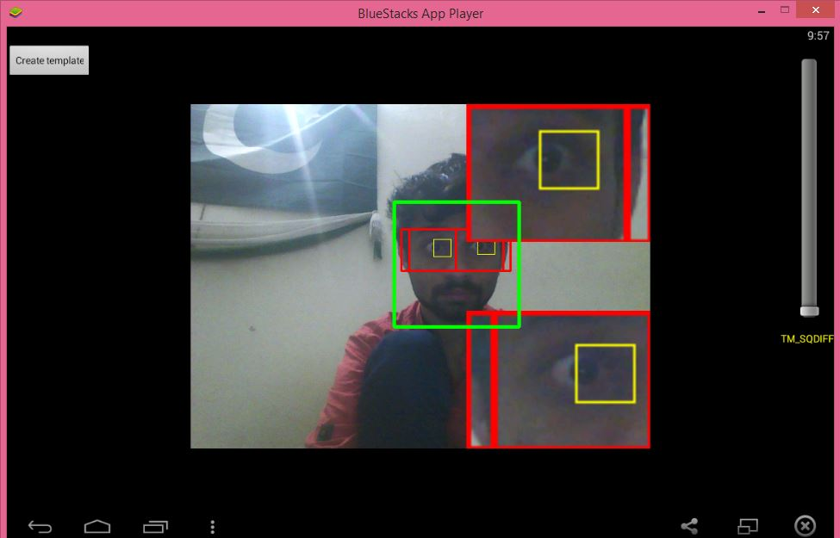
Gaze Tracking:

Slide 14
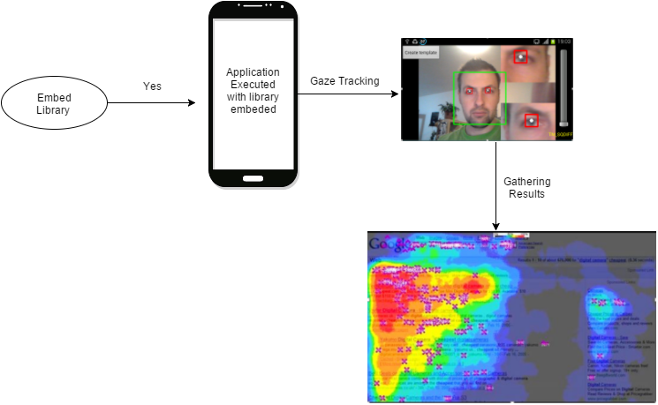
System Model Diagram

Slide 15
Questions ?

Slide 16
Thank You!

